Slide 1
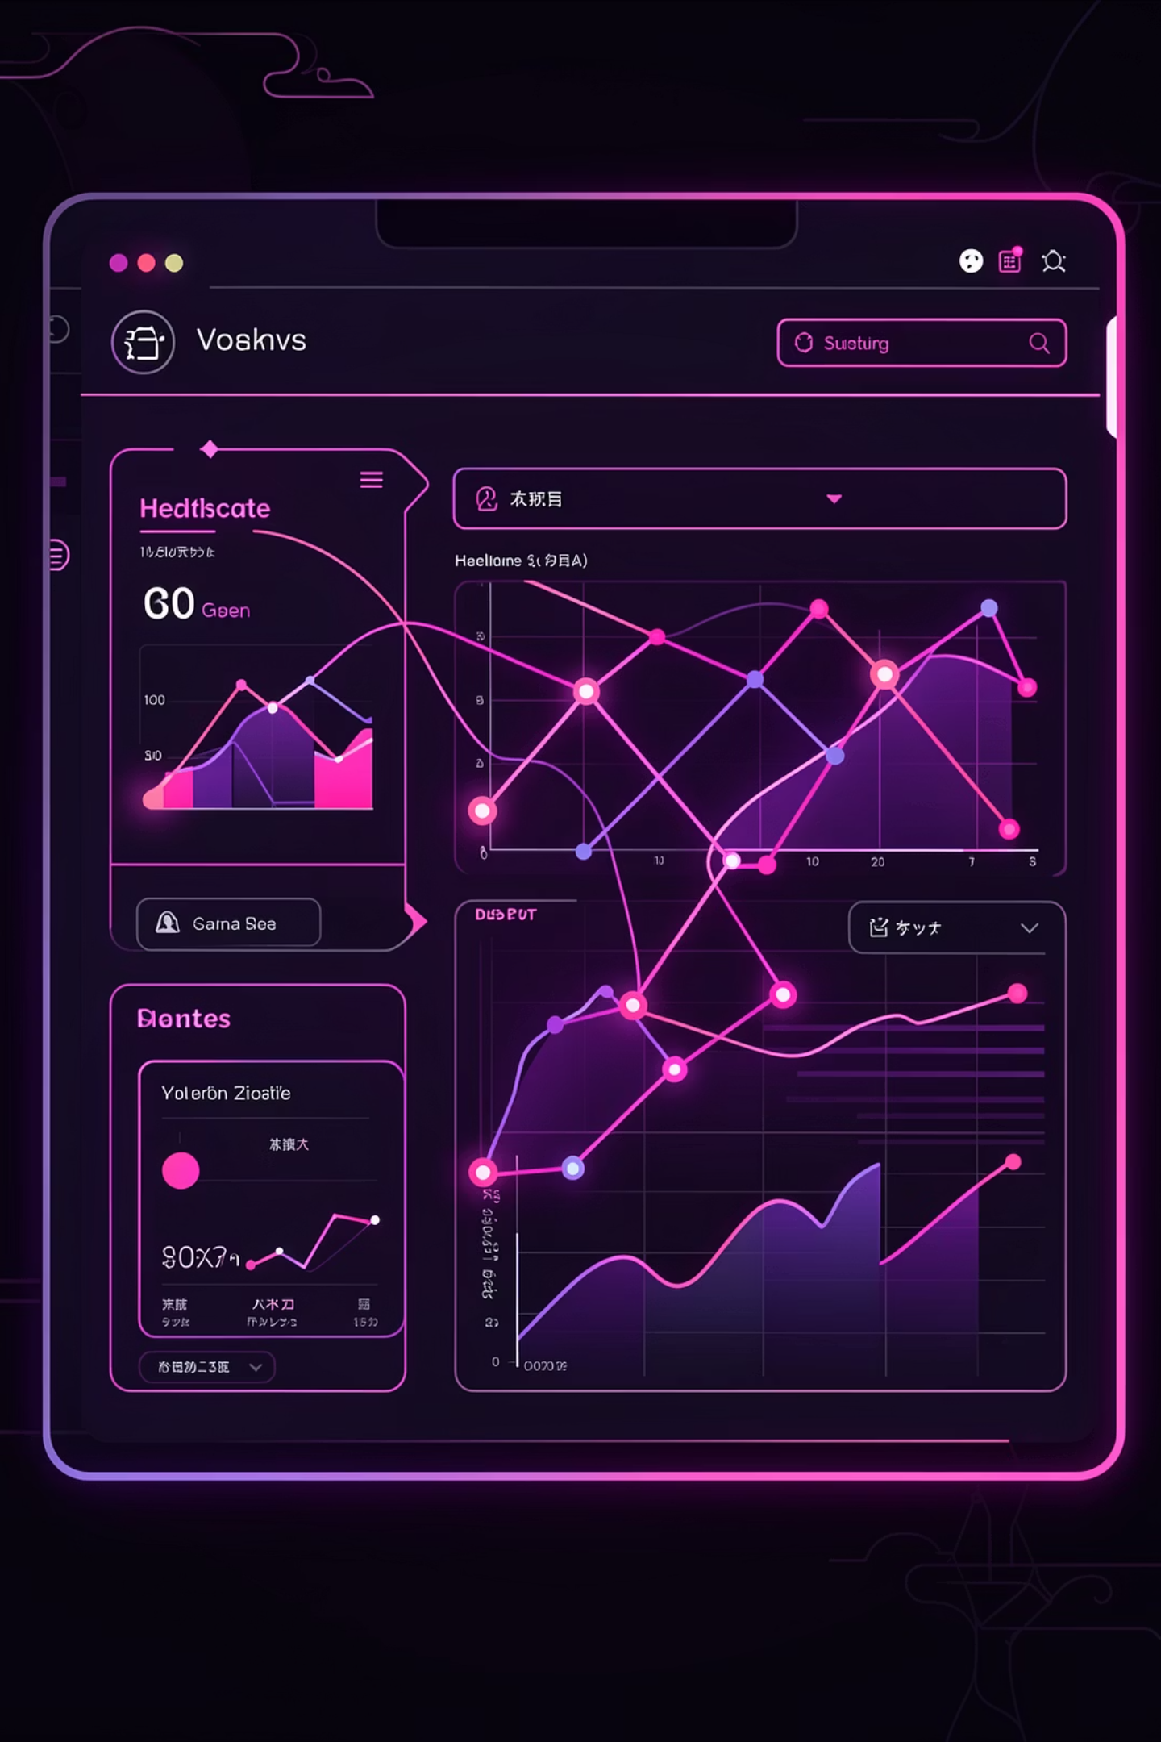
Vigilance AI
Turning the chaos of global conversation into the clarity of strategic truth

Slide 2

The Challenge
The Data Gap
Once a drug hits the market, pharmaceutical companies lose direct visibility into patient experiences. Real-world patients are discussing side effects and efficacy on social media every single second.
But this feedback is unstructured, scattered across platforms, and buried in noise. The gap between patient voices and pharmaceutical strategy is widening.

Slide 3






The Solution
Vigilance AI is a real-time market perception engine that bridges the gap between raw patient conversations and actionable pharmacovigilance insights.
Continuous Monitoring
Smart Analysis
Tracks social conversations 24/7
Distinguishes clinical signals from noise
Risk Detection
Strategic Insights
Flags adverse events automatically
Visualizes market perception

Slide 4




How Vigilance AI Works
Ingest
Analyze
Continuously crawls Twitter/X, Reddit, and News APIs for real-time patient conversations
NLP distinguishes clinical sentiment from general noise and slang terms
Detect
Visualize
Automatically flags potential adverse events for safety review
Dashboard tracks share of voice, sentiment trends, and geographic hotspots

Slide 5

Technical Architecture
Fully serverless, event-driven solution built for maximum scalability and efficiency.
1
2
3
Infrastructure as Code
Data Ingestion Layer
Data Lake Storage
Provisioned entirely with Terraform on AWS cloud platform
Python scripts on AWS Lambda continuously crawl social platforms and news APIs
Raw text stored in S3, triggering downstream processing functions automatically
4
5
AI/ML Processing
Real-Time Dashboard
spaCy and Transformers perform Named Entity Recognition to identify drugs and symptoms
React frontend with Tailwind CSS pulls live data from DynamoDB

Slide 6
Key Technical Challenges
Medical Nuance
State Management
API Rate Limits
Teaching the AI that "This drug kills pain" is positive, but "This drug is killing me" is negative required sophisticated context analysis and training data curation.
Debugging complex dependencies in Terraform state files demanded meticulous version control and modular architecture design.
Handling strict rate limits from social platforms using exponential backoff strategies while maintaining real-time performance.

Slide 7



Technical Achievements
1
2
3
Data Latency
Idle Cost
Data Quality
From tweet posted to dashboard visibility
Architecture scales to zero when not processing
Pre-processing determines AI success rate
Successfully detected slang terms for side effects in unstructured text, demonstrating robust NLP capabilities in noisy real-world data.

Slide 8
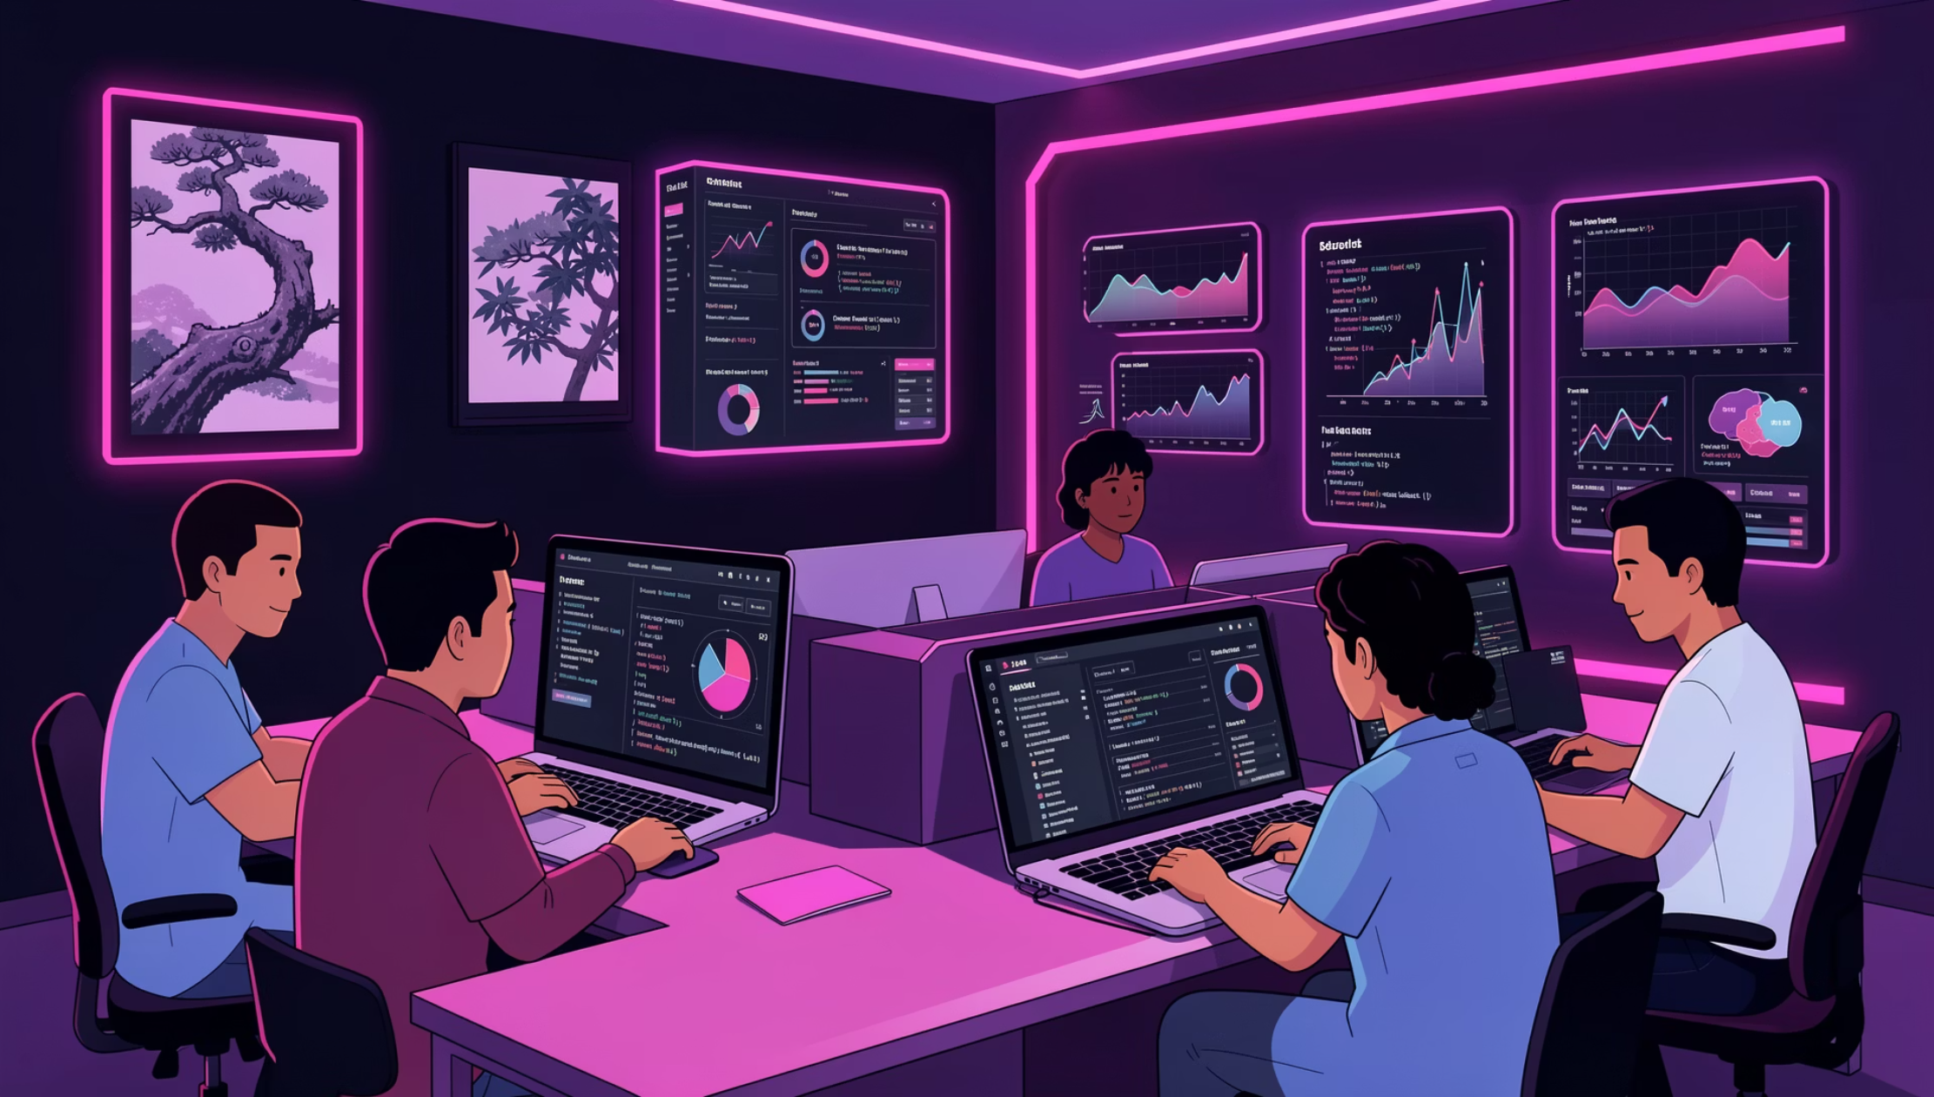

What We Learned
Data Quality is Everything
80% of AI success comes from pre-processing and cleaning data to remove noise
Cloud Event-Driven Power
S3 triggers effectively decouple ingestion from processing for scalability
Healthcare Compliance
Explainability in healthcare AI is not optional—it's critical for trust and regulation

Slide 9
Future Roadmap
Global Expansion
Persona Detection
Add multi-lingual support for European and Asian markets to enable worldwide pharmacovigilance
Predictive Analytics
Distinguish between posts from doctors, patients, and other stakeholders for targeted insights
Forecast sentiment trends before they happen using advanced time series modeling and pattern recognition

